Slide 1
FAKE NEWS DETECTION SYSTEM
Presented By
Supriya Das (11571020020)
Saheb Mukherjee (11571020039)
Sayan Das (11571020040)
Under the supervision of
Mr. Arijit Dey
Asst. Prof., Dept. of Computer Applications
B. P. Poddar Institute of Management and Technology

Slide 2
INTRODUCTION:
Social media platforms are incredibly influential.
According to internet live stats the estimated daily number of tweets is about 500 million. These platforms are ubiquitous.
This provides ideal conditions to distribute news with minimal guidelines and restrictions.
Receive news from online sources like social media.
Real news may be twisted in transmission. A reader may end up with different versions of the same news. This may lead to information overload.

Slide 3

THE TYPES OF FAKE NEWS DETECTION BEING USED:
Manual Fake News Detection
Manual fake news detection often involves all the techniques and procedures a person can use to verify the news. It could involve visiting fact checking sites.
Automated Fake News Detection
Automated detection systems provide value in terms of automation and scalability. There are various techniques and approaches implemented in fake news detection research.
Here we approach two types methods:
Machine Learning Approach.
Deep Learning Approach.

Slide 4
OBJECTIVES:
To build a model to accurately classify a piece of news as real or fake.
To provided user with the ability to classify the news real or fake and also check the authenticity of the website publishing the news.
Journalists may publish news whose sources are unverified, or without carrying out any form of fact checking themselves. Here we verified fully for publishing.

Slide 5
METHODOLOGY:
As we need to classify whether the given news is real or fake, So we are going to use a model which has the ability to use supervised machine learning technique which is based on a classification algorithm
Logistic Regression
Naive Bayes
K-Nearest Neighbors
Decision Tree
Support Vector Machines

Slide 6
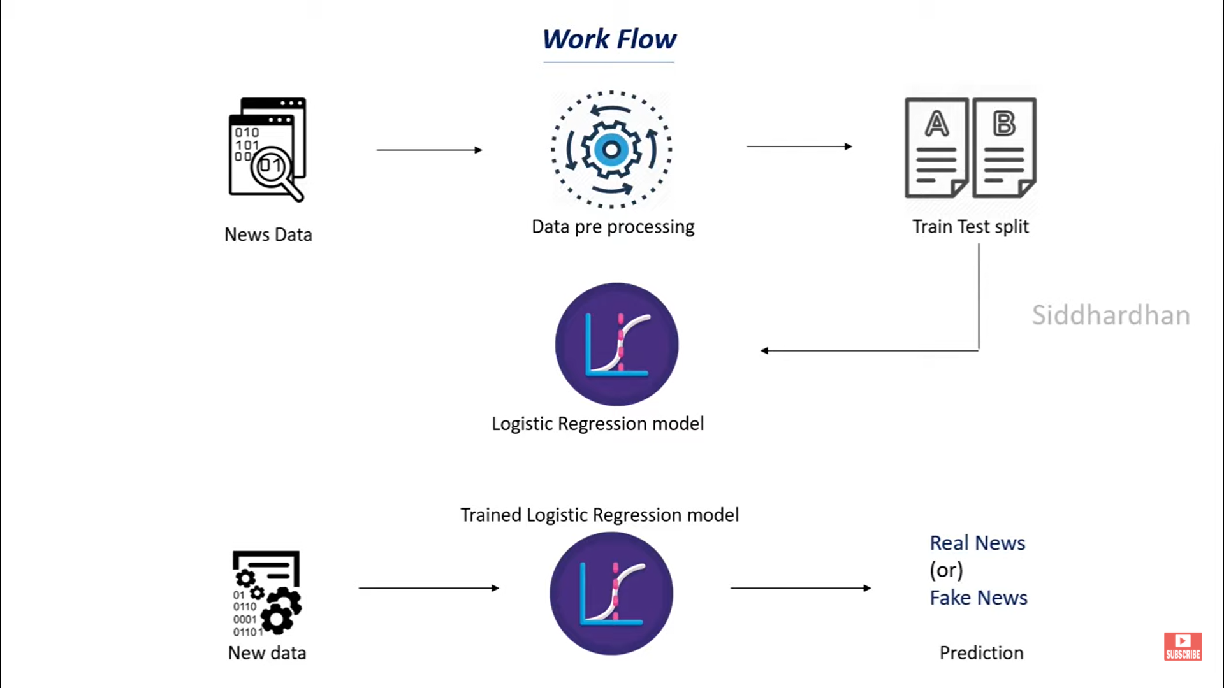
Proposed Methodology (Block Diagram):

Slide 7
HOW MUCH HAVE WE GONE THROUGH?
UNDERSTANDING THE NEEDS FOR THE PROJECT
COLLECTING DATASET
UNDERSTANDING NECESSARY ALGORITHMS
DATA CLEANING
AND DATA RESHAPING

Slide 8
THINGS STILL ARE ON WORK:
APPLYING DIFFERENT ALGORITHM
DEPLOYING THE PROJECT
TRAINING THE DATA
TESTING THE DATA
GET THE ACCURACY RESULT
CHOOSING THE BEST ALGORITHM

Slide 9
EXPECTED OUTCOME:
We are expecting a model which would be able to accurately predict the news to be fake or real with highest accuracy rate compare to all the models have till now.

Slide 10
REFERENCES:
Dataset link
www.Kaggle.com
Reference link
www.javatpoint.com
www.tutorialpoint.com

Slide 11
THANK YOU….

